Slide 1
<html> - Starting Fresh
Unit 12
The Data Bootcamp
Notes:
Welcome students.
This week we will learn to build and deploy websites. Before we dive in to coding, we’re going to have a quick overview of some of the technologies we’ll be learning over the next few days and weeks.
Start with a question: What is the Web? (don’t wait for answers, just go to next slide)

Slide 2
What is the Web?
Notes:
The web is a series of tubes, and they’re full of cats!

Slide 3
What is the Web?
But how do these tubes get filled with cats?
Notes:
But how do these cats get in to these tubes?

Slide 4
What is the Web?
Web developers build them in to a special type of document - a web page.
These web pages are then accessible to other people on the Internet.
(Believe it or not, you can even build web pages with things other
than cats on them.)
Notes:
“Web developers build them into web pages.”
The Web isn’t really a series of tubes, though.
It’s a system of computers that support special types of documents (web pages). Those computers allow other people on the internet to access these documents.
You can request these pages from other people, or create and host your own.
We already know how to request web pages (we use our browser!).
We want to know how to do the second - host our own web pages.

Slide 5
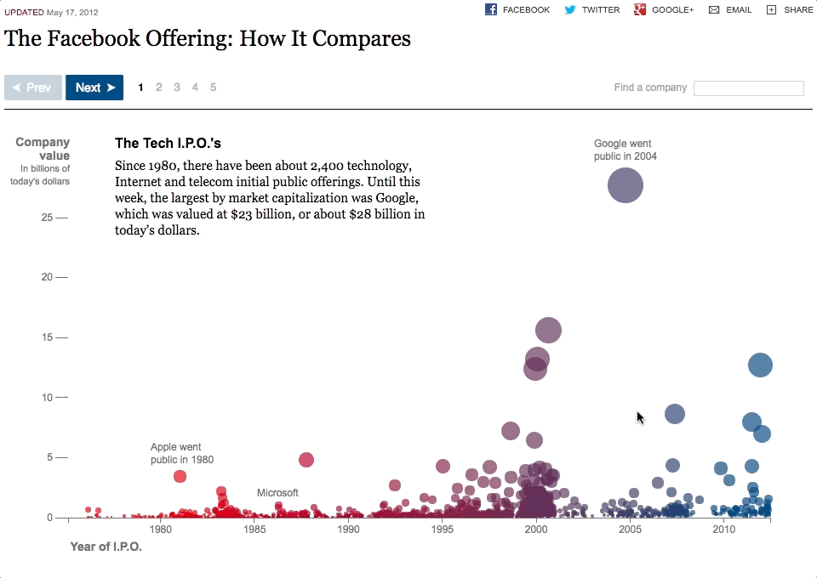
What is the Web?
Data analysts can use the web to tell stories with data, and reach millions of people.
Notes:
Importantly, we can use the web to share insights into data with our users.
Interactive and dynamic charting is very powerful, and can help you do additional analysis on data.
Here we see an example analysis on the Facebook IPO
http://www.nytimes.com/interactive/2012/05/17/business/dealbook/how-the-facebook-offering-compares.html

Slide 6

The Web - Discuss
Discuss with partners!
What are some technologies used in front-end web development?
What can you tell us about each technology, i.e. what is its role in a website?
Notes:
“To know how to build and host these web pages ourselves, we have to understand a few things.”
Have students look up and discuss some front-end web technologies with partners.
After 2 or 3 minutes, have students offer up some of their answers.
Students may offer up more specific answers than we may be looking for, e.g. the Bootstrap CSS framework or the Angular JavaScript Framework or similar. Anything used to build websites on the front end is a correct answer here.

Slide 7
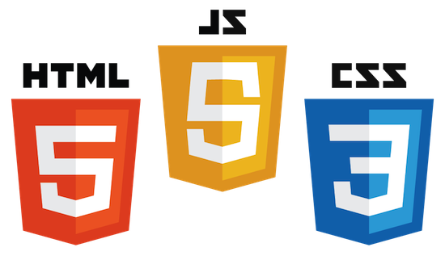
The Core Three Front-End Web Technologies
Notes:
Explain that while there are a number of front-end web frameworks and libraries, at the end of they day, we’re using HTML, CSS, and JavaScript to build websites. These technologies are the three pillars of the front end web.
HTML is the important one for today, but we’re going to do a high level overview of CSS and JavaScript as well.
So what is HTML?

Slide 8


<title> Intro to HTML </title>
HTML is one of the three base languages behind every website.
It defines all of the content of a web page.

Slide 9
HTML
Stands for “Hypertext Markup Language”. It’s responsible for a page’s content and structure.
Elements are the basic building blocks of web pages.
Notes:
Being a markdown language, HTML doesn’t use variables or loops or functions or have any kind of programming logic.
Instead we use HTML tags to declare what should be rendered to the page in the browser.
There are a lot of different elements!

Slide 10
HTML
HTML elements are rendered by the browser as visible parts of a web page.
Notes:
Being a markdown language, HTML doesn’t use variables or loops or functions or have any kind of programming logic.
Instead we use HTML tags to declare what should be rendered to the page in the browser.

Slide 11
HTML Syntax (Basic)
Content
<h1>
Welcome!!!
</h1>
Opening Tag
Closing Tag
Notes:
HTML tags are written using angle brackets.
*Most* HTML elements follow the format of:
Opening tag
Content
Closing tag
Can students guess what this tag might be used for?
It’s a heading tag. They come in 6 numbered sizes (h1-h6), with h1 having the largest text and being the most important
Heading elements can help describe and section off our content.
Search engines may look at heading tags to try to understand what a web page is about.

Slide 12
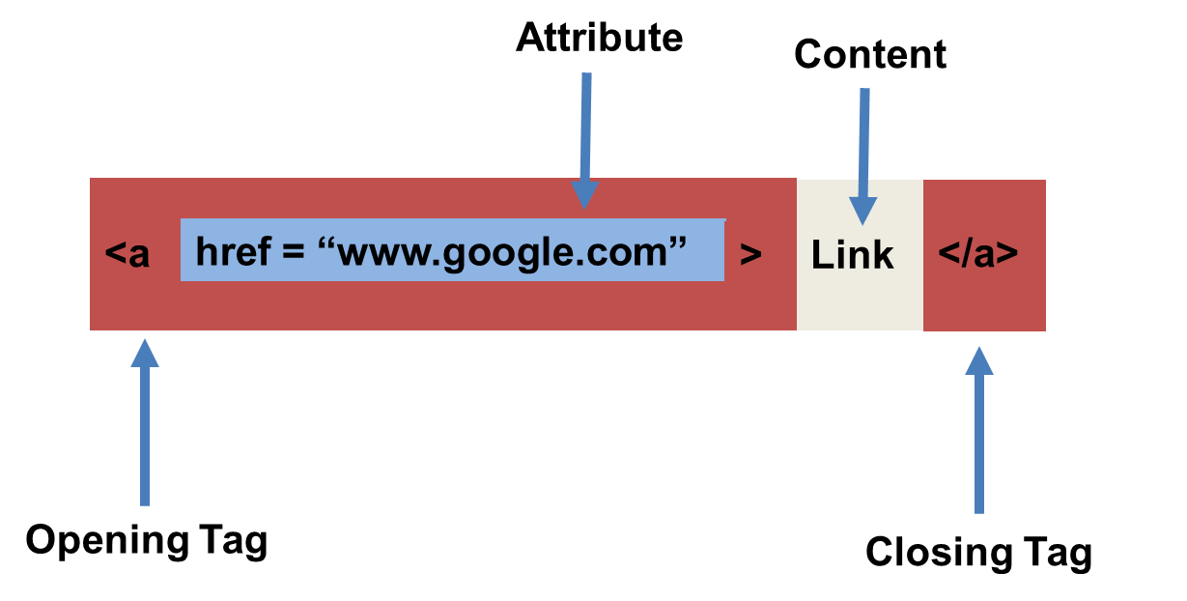
HTML Syntax (with Attribute)
Notes:
Some HTML tags have attributes they are commonly paired with.
An attribute acts as a modifier for an HTML element. They either modify an element’s default behavior, or they can provide functionality to certain elements which are unable to otherwise function without them.
Q: What does this tag look like it’s doing?
In this example, we have an anchor tag, which when rendered to the page creates a hyperlink. The “href” attribute describes the URL that the user should be brought to after clicking the rendered link.

Slide 13
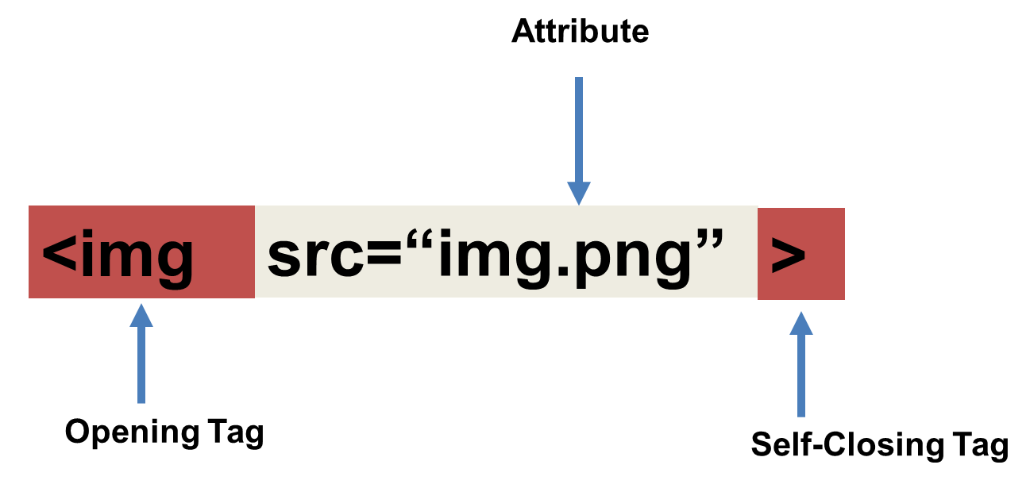
Tricky Tags (Self-Closing)
Notes:
While most elements have an opening and closing tag, a few are self closing. These are known as void elements.
Q: Can you guess what this element is?
An img tag creates an image element, and the src attribute describes the path or URL of the image to display.
We don’t pass any content into an img tag, and it doesn’t need a closing tag.

Slide 14

CSS
CSS describes how and where elements should appear on the page.
It defines things such as color, placement, fonts, sizes, and more.

Slide 15
CSS
Stands for “Cascading Style Sheets”.
Responsible for a web page’s presentation.
Describes how each HTML element should appear on the screen. This can be anything from how/where an element is positioned to its size, color, and much more.
CSS is what makes web pages look good.
CSS rules are made up of selectors and declarations.

Slide 16

CSS Syntax
CSS works by adding style declarations to selectors.
If a selector matches any HTML elements, the browser will apply the defined styles to those elements.
Notes:
The selector is how we “select” which elements need to be affected by the CSS declaration.
One type of selector is the element tag name.
Ask students what they think this code might do?
It will give every rendered link on the page a yellow background.
Assure students we’ll cover this in depth tomorrow, so no need to memorize this now or take notes.

Slide 17

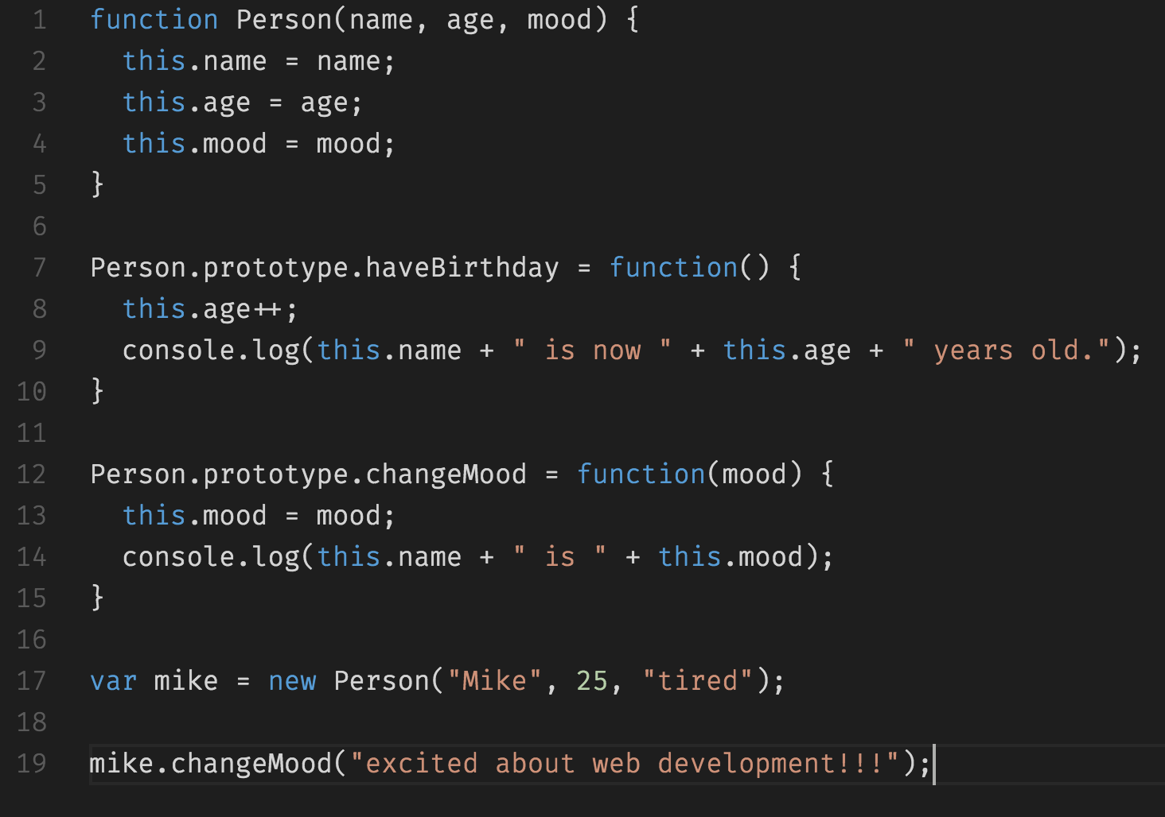
JavaScript
JavaScript is used to handle programming logic and give websites interactivity.

Slide 18
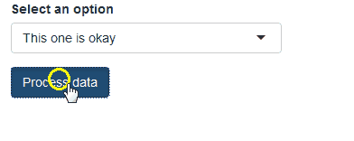
JavaScript
A scripting language created for the front-end web. It’s responsible for a web page’s behavior.
Used to add, remove, or alter HTML elements and their CSS in a web page dynamically.
Handles events such as clicks, key presses, form submissions, and more.
Can be used to perform API requests from the browser.

Slide 19
Over The Next Few Weeks…

Slide 20
All the Technologies!
We Will Cover:
HTML
CSS
Bootstrap CSS
JavaScript
JavaScript Charting Libraries
And more…
Notes:
We have a lot of ground to cover, but students will be capable frontend developers in a few weeks.

Slide 21
Why Do We Need All This?

Slide 22
To Visualize Cats!
Notes:
To visualize cats!

Slide 23
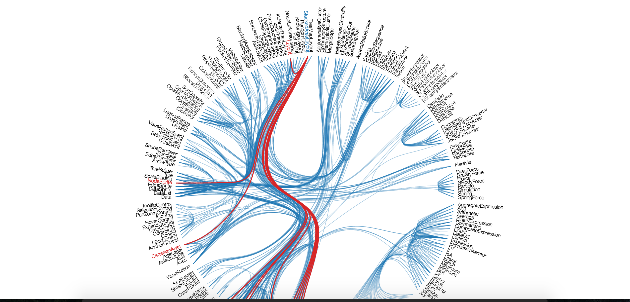
Visualizations (e.g. D3)
We’ll be able to use HTML, CSS, and JavaScript to create some VERY impressive interactive visualizations with big data. View Gallery
Notes:
And to visualize other things too, I suppose…
In order to provide some context as to why we’re learning web development now, show students some of the visualizations that can be created using D3 and other JavaScript charting and mapping libraries
“This opens up whole new possibilities for the types of visualizations we can create with our data.”
Spend a few minutes going through the D3 gallery as a class.

